Slide 1


Slide 2

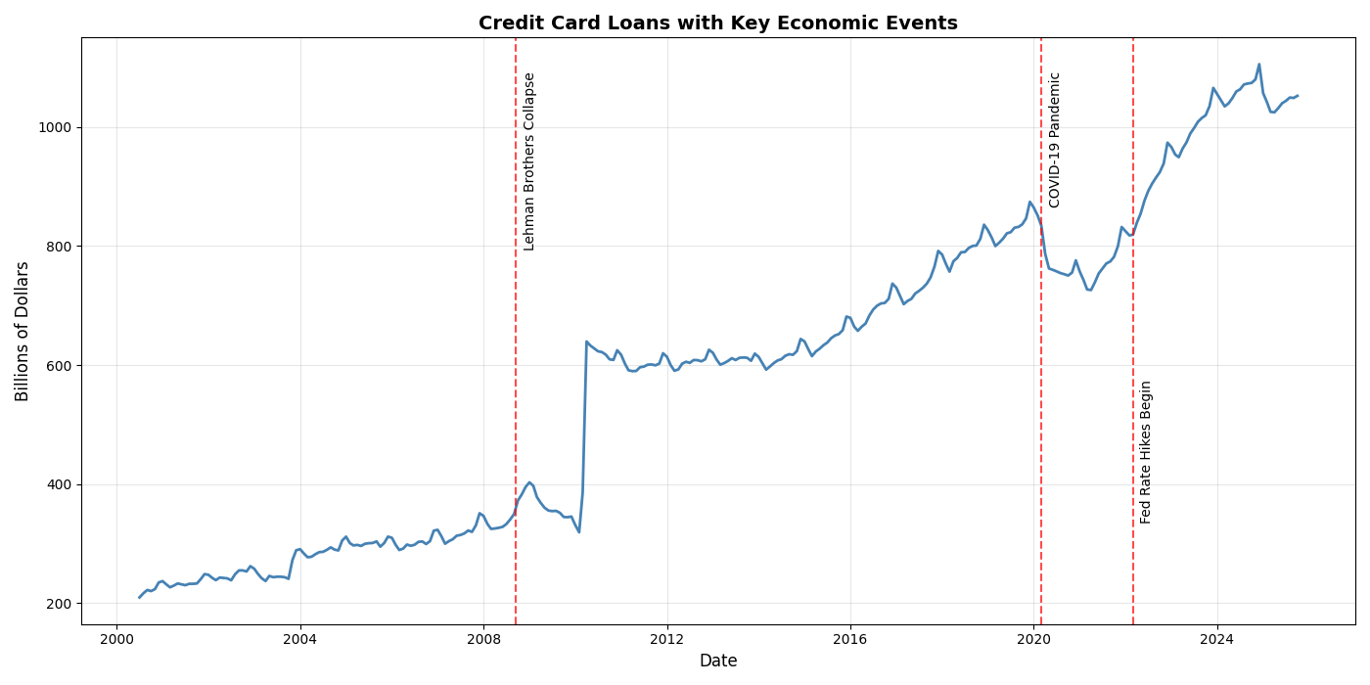
RESEARCH QUESTION AND MOTIVATION
The Problem:
Consumer credit card loans = $1.1 trillion (2024)
Highly volatile—reacts sharply to economic shocks
Dropped $122 billion in the start of COVID-19
Research Question: Which time-series model best forecasts one-step-ahead monthly changes in U.S. consumer credit?
Do seasonal patterns or macroeconomic factors improve accuracy?
Why It Matters:
✓ Early warning signals for financial stress
✓ Risk management for financial institutions
✓ Policy insights for Federal Reserve decisions
✓ Understanding household financial health

Slide 3
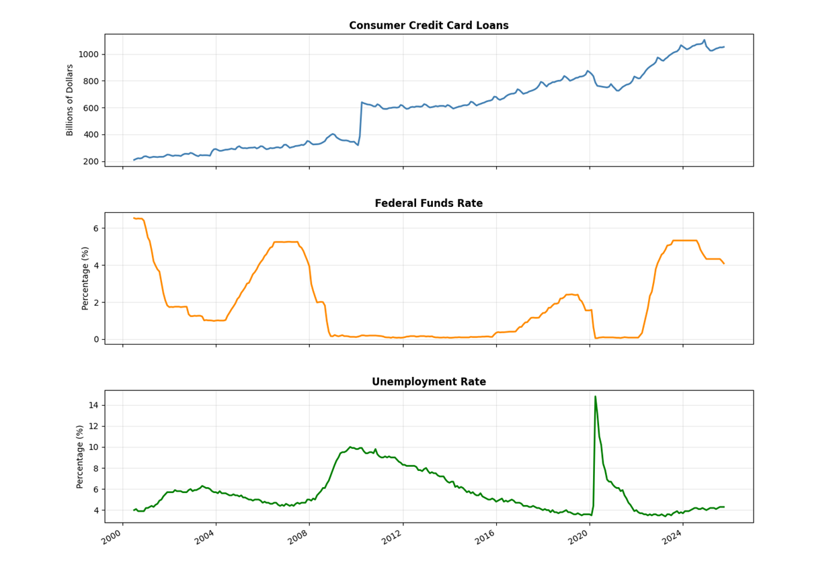
DATA OVERVIEW
Data:
Credit card loans: 304 months (Jul 2000 - Oct 2025)
Growth: 428% over sample period
Exogenous variables:
Fed Funds Rate,
Unemployment Rate
Train-Test Split:80% training (2000-2020) | 20% test (2020-2025)
Test period captures COVID-19 shock

Slide 4
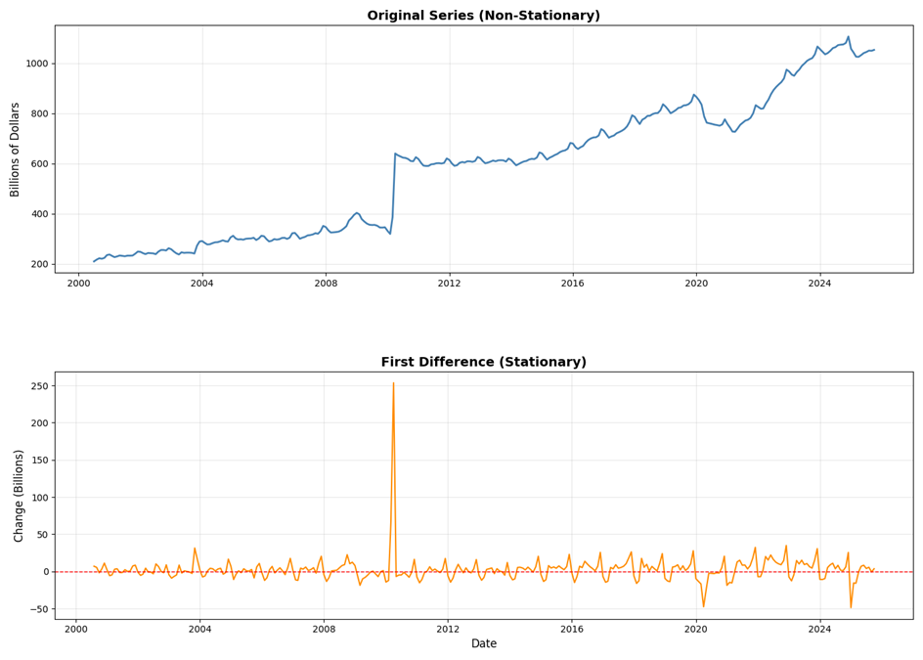
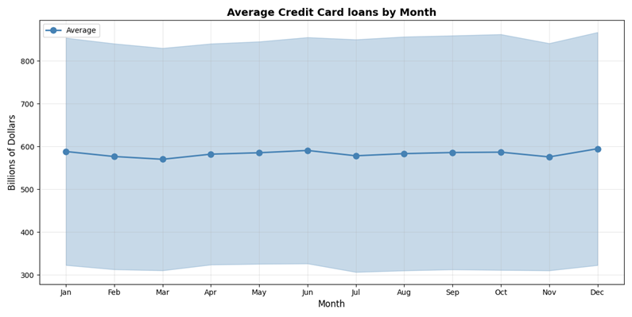
STATIONARITY & SEASONALITY
Seasonality
Clear December peak driven by holiday shopping behavior
Summer months (June) show elevated credit usage
March dip reflects post-holiday spending pullback and tax season
Seasonal swings demonstrate consistent annual patterns
Implication: Seasonal ARIMA models can capture these recurring fluctuations
Stationarity
Original series shows strong upward trend—not stationary
Statistical tests confirm unit root presence (p = 0.94)
First differencing removes trend, achieves stationarity
Implication: All models require d = 1 differencing

Slide 5
MODEL SPECIFICATIONS
ARIMA(0,1,1) - Baseline Model
Captures month-to-month changes in credit card loans
Treats all months as identical (no seasonal awareness)
Simple one-step-ahead forecasting approach
Serves as our benchmark for comparison
BIC = 2110.32
SARIMA(0,1,1)(0,1,1)₁₂ - Seasonal Enhancement
Extends ARIMA by recognizing recurring annual patterns
Captures December holiday peaks and March tax-season lows
Automatically adapts to predictable seasonal credit cycles
BIC = 1904.42 (Best model fit ✓)
SARIMAX(0,1,1)(0,1,1)₁₂ - Macroeconomic Integration
Builds on SARIMA by incorporating external economic predictors
Includes Federal Funds Rate (monetary policy signal)
Includes Unemployment Rate (economic health indicator)
Tests whether macroeconomic context improves forecast accuracy
BIC = 1908.63

Slide 6
ROLLING WINDOW METHODOLOGY
Real-World Forecasting Simulation:
Generate 61 consecutive one-step-ahead forecasts (Oct 2020 - Oct 2025)
Each model is re-estimated monthly as new data becomes available
Mimics how forecasters operate in practice: update and predict iteratively
How the Rolling Window Works:
Fit model using all historical data available up to month t
Generate forecast for the next month (t+1)
Wait for actual value at t+1 to be observed
Expand training dataset by adding the new observation
Re-estimate model parameters and repeat
Performance Evaluation Metrics:
RMSE: Root Mean Squared Error – penalizes large forecast errors heavily
MAE: Mean Absolute Error – average magnitude of errors in billions
MAPE: Mean Absolute Percentage Error – scale-free measure for comparison

Slide 7
PERFORMANCE COMPARISON
Model | RMSE ($ Billion) | MAE ($ Billion) | MAPE (%) | BIC (Training)
ARIMA(0,1,1) | 13.92 | 10.29 | 1.12 | 2110.32
SARIMA(0,1,1)(0,1,1)₁₂ | 9.39 | 6.73 | 0.74 | 1904.42
SARIMAX(0,1,1)(0,1,1)₁₂ | 9.40 | 6.75 | 0.74 | 1908.63
Key Findings:
✓ SARIMA improves 32.5% over ARIMA across all metrics
x SARIMAX adds no value over SARIMA (virtually identical)
SARIMA MAE = $6.73B (approximately 0.7% of average credit)
206-point BIC improvement strongly justifies seasonal structure
Why SARIMA Is Better:
Explicitly captures December peaks and March lows
Adapts faster to growth rate changes
Seasonal differencing handles year-over-year patterns

Slide 8
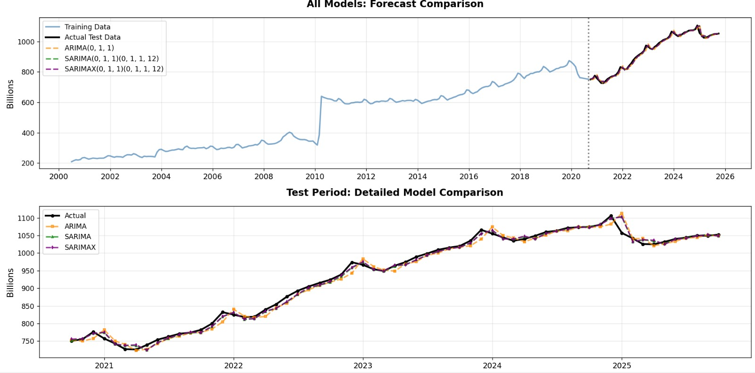
VISUAL EVIDENCE: FORECASTS VS ACTUALS
Test Period Analysis (Oct 2020 - Oct 2025):
Phase 1: Initial Recovery (Oct 2020 - Mar 2021)
All models underpredict as recovery accelerates faster than expected
SARIMA/SARIMAX adapt more quickly than ARIMA
Phase 2: Rapid Surge (Apr 2021 - Dec 2022)
Credit grows 34% in 21 months—unprecedented pace
ARIMA systematically lags behind actuals throughout
SARIMA/SARIMAX track much closer but still miss peak growth
This period generates most forecast errors
Phase 3: Stabilization (Jan 2023 - Oct 2025)
Growth moderates; all models improve substantially
SARIMA/SARIMAX forecasts nearly indistinguishable from actuals

Slide 9
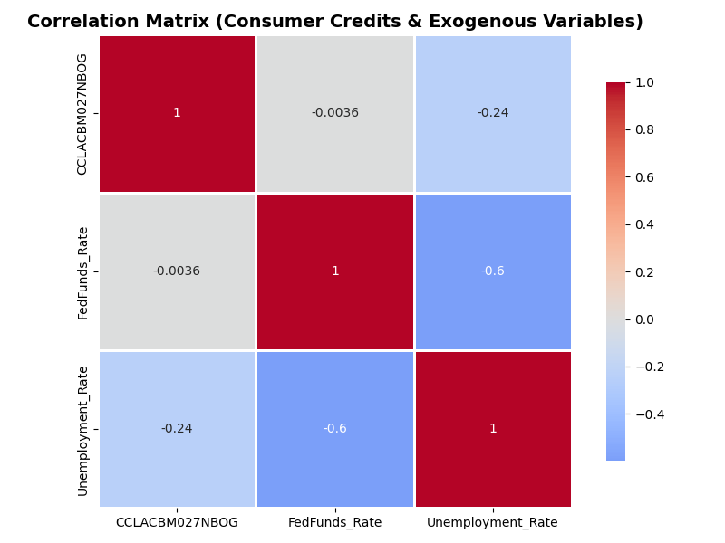
WHY SARIMAX DOESN’T IMPROVE SARIMA?
Evidence:
Fed Funds Rate: Correlation ≈ 0, p = 0.988 (statistically insignificant)
Unemployment Rate: Correlation = -0.24, p = 0.007 (significant but adds no forecasting value)
BIC penalty: 4.21 points worse than SARIMA
Forecast accuracy: Identical to SARIMA (RMSE 9.40 vs 9.39)
Explanation:
Information redundancy: Seasonal patterns already reflect economic conditions
Short forecast horizon: Recent credit values dominate one-step-ahead forecasts
Slow-moving variables: Unemployment changes gradually; effects already captured in lagged credit
Implicit information: Rapid credit growth signals strong economy without needing explicit variables

Slide 10
CONCLUSION
⚠ Limitations:
Structural breaks: Max errors $46.22B during 2021-2022 surge—linear models can't anticipate regime shifts
Point forecasts only: No confidence intervals; uncertainty likely underestimated
Short horizon: 1-month forecasts only—performance may degrade at 6-12 months
Sample period: COVID-19 recovery only—untested in normal conditions
Linear specification: Cannot capture threshold effects or asymmetric shocks
Main Findings:
Seasonality is crucial: 32.5% accuracy improvement over ARIMA
Macro variables add no value: SARIMAX identical to SARIMA for 1-step forecasts
SARIMA wins: Best model—accurate, parsimonious, interpretable
Strong statistical justification: 206-point BIC improvement on ARIMA

